Slide 1

Generative Artificial Intelligence Part 1
CS 180 Introduction to Data Science
Notes:
Gemini 3 Prompt: Generative AI creates a future world of incredible possibilities

Slide 2
Agenda
What is Generative Artificial Intelligence? Let’s ask it!
What are Large Language Models? Let’s ask it!
The process of building LLMs
Prompt engineering
Retrieval Augmented Generation
Fine-Tuning
Case study #1: unstructured text analysis for autism interviews
Case study #2: depolarizing chatbots
Quiz

Slide 3
Where does Generative AI Fit?
Generative AI:
Scope: Use of multi-modal inputs (text, image, video, audio) to generate contextually relevant content.
End Goals: Leverage deep learning and other neural network techniques to generate new, realistic, content.
Key Concepts: Tokenization, Embedding, Large Language Models, Prompt Engineering, Retrieval Augmented Generation, Fine-Tuning, etc.
Artificial Intelligence
Data Science
Visualization
Data Analysis
Machine Learning
Streaming
Data
Statistics
Deep Learning
Large-Scale
Data Collection
Generative AI
DBMS
Data Engineering

Slide 4
What is Generative AI?
What does ChatGPT tell you? Try it!

Slide 5
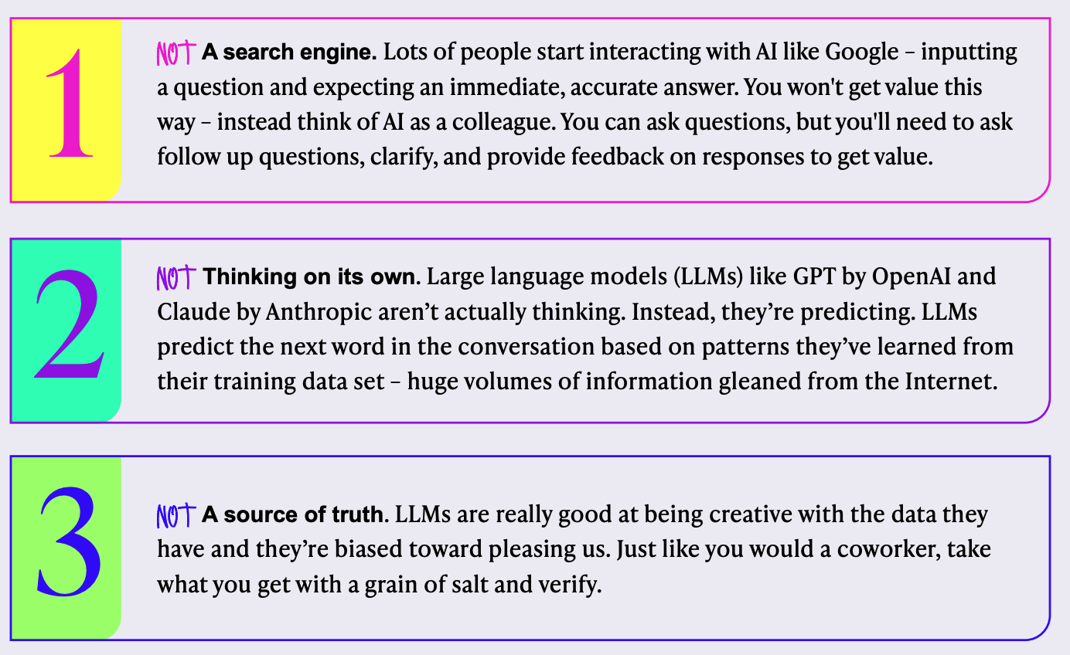
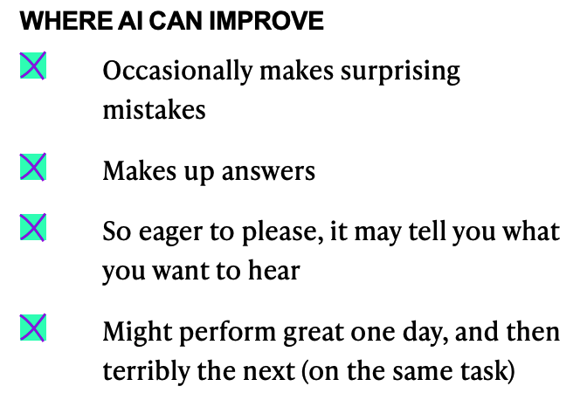
What Generative AI is NOT…
Notes:
From “The Executives Guide to Generative AI v.04”

Slide 6
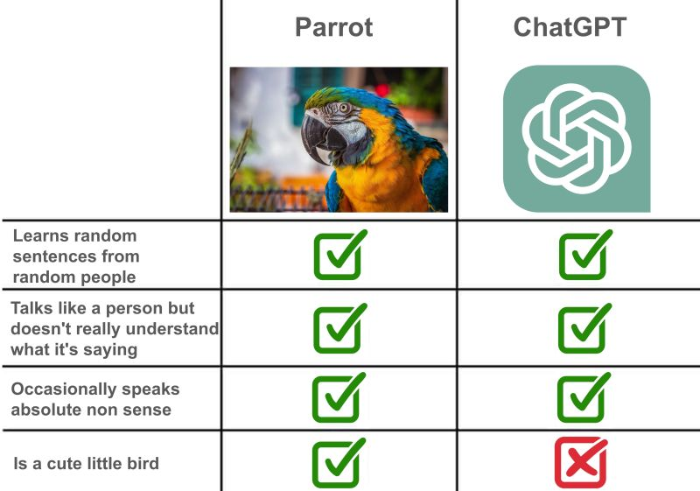
Are GenAI Systems Just “Stochastic Parrots”?
The phrase "stochastic parrot" was introduced in 2021 by computer scientists Emily M. Bender, et. al. in a paper titled "On the Dangers of Stochastic Parrots: Can Language Models Be Too Big?"
The term critiques large language models (LLMs), suggesting that, while these models mimic human language by predicting words based on patterns in their training data, but they lack true understanding or reasoning capabilities.
Instead, they simply stitch together language patterns, akin to parrots that replicate speech without comprehending meaning.
Advanced models can simulate reasoning by generating coherent responses or problem-solving steps, but this is not the same as human reasoning.
Will GenAI systems eventually cross the threshold to human-like reasoning? This is an ongoing debate.

Slide 7
Key Idea:
Many language related problems can be framed as
predicting the next word

Slide 8
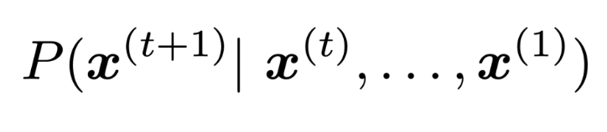
Predicting Next Word formulated as a probabilistic model
Can you please come here?
History / context
Predicted
word
Predicted
word
History / context
Can you please come…
and help me? I'm sorry, but I can't come and help you in person. However, depending on what kind of help you need, I may be able to provide advice or resources that can help.
to my house? I'm sorry, but I cannot come to your house.
up with a plan to reduce the cost of producing these products?
Notes:
AUDIENCE PARTICIPATION:
Predict the next word:
4 plus 4 equals
Paris is the capital of
In the movie “The Princess Bride”, Wesley and Buttercup overcame their difficulties through the power of

Slide 9
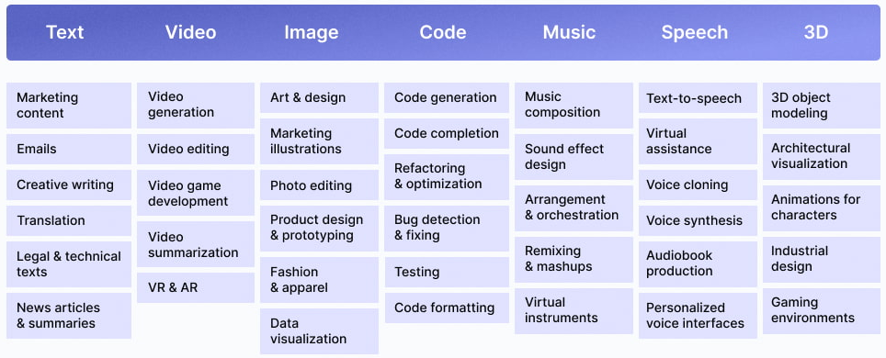
Generative AI applications

Slide 10
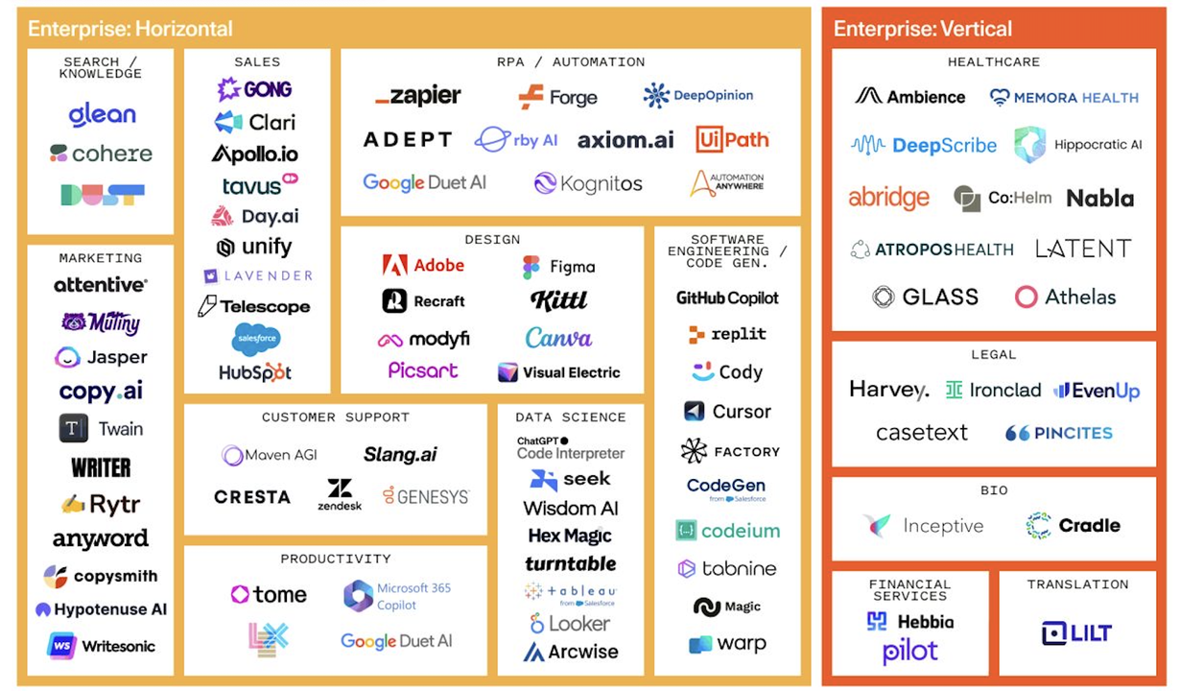
Notes:
Since 2022, over 700 AI startups have been established globally. In the U.S. alone, 524 new AI companies were founded in 2022, attracting significant private investment, including $47 billion in non-government funding. China followed, launching about 160 AI startups, each receiving an average of $71 million in private funding. Other countries like the UK, Canada, and India have also contributed to this rise, reflecting the accelerated adoption and investment in AI technologies worldwide.
By early 2024, AI startups are thriving globally, particularly in regions with high AI capacity and infrastructure like the U.S., China, and Singapore. This surge aligns with a growing trend of investment across healthcare, fintech, and cybersecurity, which are among the sectors receiving the highest AI funding.
https://www.spglobal.com/marketintelligence/en/news-insights/latest-news-headlines/how-top-vcs-are-placing-their-growing-ai-bets-81722741

Slide 11
Some common GenAI Products
Product | Category | Description | Use Cases
ChatGPT (OpenAI) | Conversational AI / Assistant | A large-language-model-powered chatbot accessible via web/mobile used by tens of millions of adults. | Asking questions, drafting writing (emails, essays), brainstorming ideas
Gemini (Google) | Multimodal AI assistant / model | Google’s flagship multimodal AI (text, image, audio) with enhanced reasoning and coding in its 3.0 versions released in 2025. | Complex queries, image + text prompts, coding help, creative generation,
Midjourney | Text-to-image generation / Creative visuals | A popular AI image-generation tool that converts text prompts into high-quality, stylized visuals. Maintains strong usage among creators in 2025. | Creating illustrations, concept art, social-media visuals, mood boards, product mock-ups.
Suno AI | Music Generation | Creates full songs (lyrics, vocals, melody) from text prompts. | Music creation, jingles, personal projects, entertainment.
NotebookLM (Google) | Research / Knowledge-assistant | An AI tool aimed at helping with knowledge work: importing PDFs/websites/videos, generating summaries, mind-maps, audio overviews. | Academic research, studying, briefing documents, summarizing large content corpora, knowledge synthesis.

Slide 12
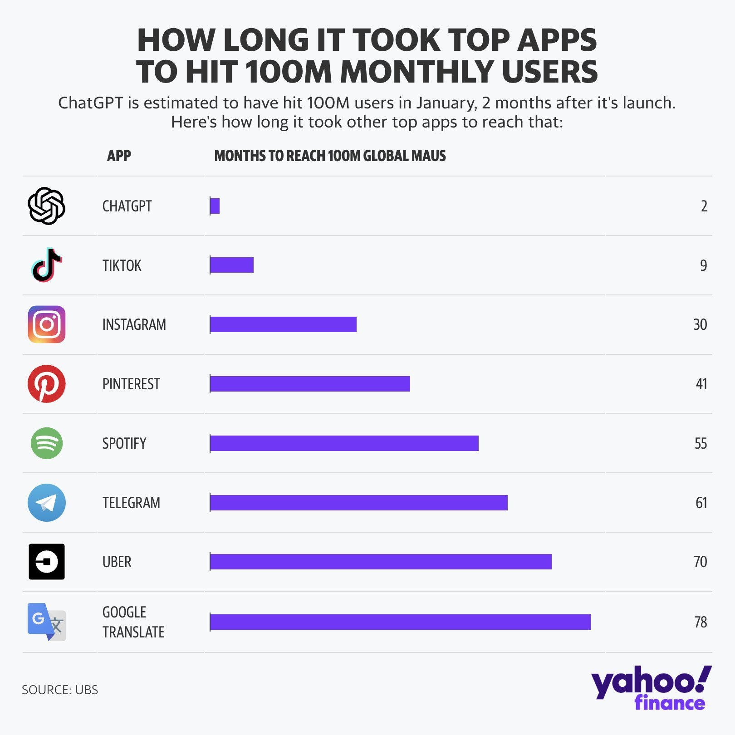
Generative Pre-Trained Transformer (GPT)
Generative: Model can generate new data—in this case, human-like text. Given an input (like a question or prompt), GPT predicts and generates a sequence of words to respond.
Pre-trained: Before it's fine-tuned for specific tasks, GPT undergoes a large-scale "pre-training" phase on massive amounts of text data. During this phase, it learns grammar, facts about the world, and common patterns of human language by predicting the next word in millions of text sequences.
Transformer: The "transformer" is the underlying architecture of GPT, which was introduced by researchers at Google in 2017. Transformers excel at handling sequential data and understanding context over long text. They use a mechanism called "attention" to weigh the importance of different words in a sequence, enabling the model to capture relationships between words, phrases, and sentences.

Slide 13
ChatGPT Statistics
The tool set a record for having the fastest-growing user base in history for a consumer application, gaining 1 million users in just 5 days.
The ChatGPT website received an estimated 1.8 billion website visitors in April 2024 (an increase of around 200 million from 1.6 billion in February 2024) with an estimated 100 million active users.
In May 2024, OpenAI announced ChatGPT-4o which can accept and generate combinations of text, images, audio, and videos.
ChatGPT contains 570 gigabytes of text data, which is equivalent to roughly 164,129 times the number of words in the entire Lord of the Rings series (estimated at over 1 trillion tokens).
It is estimated that ChatGPT-4 was trained with 100 trillion parameters, which is roughly equal to the human brain. (Source: Wired, Hix.ai)
OpenAI used 1,023 A100 GPUs to train ChatGPT and it is estimated that training the model took 34 days.
The latest estimates suggest that ChatGPT costs $700,000 per day or $21 million per month to run, with each query costing $0.36.

Slide 14
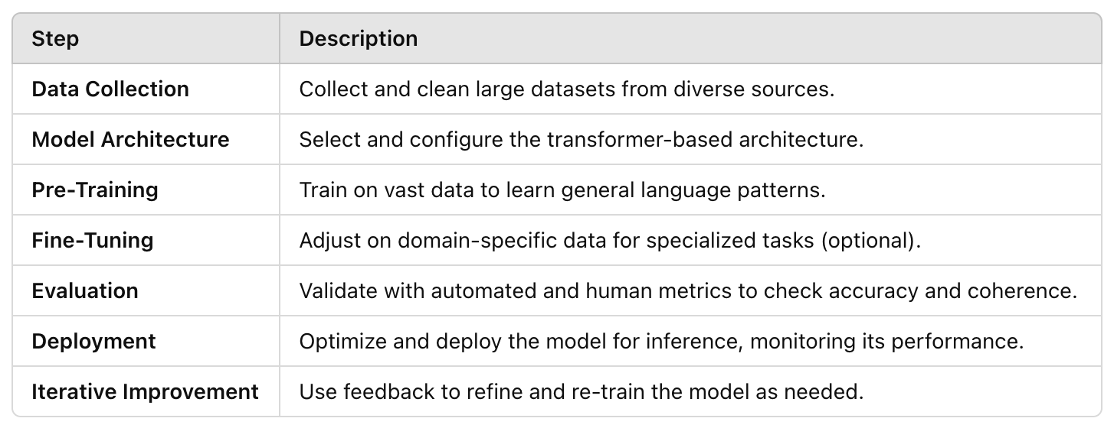
Large Language Model Development Process
The process for training a Large Language Model (LLM) is complex and involves several stages, from data gathering to model deployment. Here’s a high-level overview of each step:
By following this end-to-end process, LLMs evolve from understanding basic language patterns to performing well-defined, complex tasks with human-like language abilities.

Slide 15
Data Collection and Preprocessing
Data Collection: LLMs require vast datasets to learn language patterns, so this step includes gathering data from sources like books, websites, scientific papers, forums, and more. The goal is to collect data that captures a broad range of vocabulary, syntax, and information.
Data Filtering and Cleaning: Raw data often contains noise, irrelevant information, or duplicates. Filtering processes remove offensive or sensitive content, deduplicate entries, and exclude irrelevant parts, ensuring the model only learns from high-quality data.
Tokenization: Text data is converted into smaller units called tokens, which can represent words, subwords, or characters. Tokenization helps the model process text numerically by turning each token into a sequence of numbers that the model can interpret and process.

Slide 16
Text Tokenization
Text tokenization is the process of breaking down text into smaller units, called tokens, that a machine learning model can process and understand.
Tokens can represent words, subwords, or even individual characters.
In natural language processing (NLP), tokenization is a foundational step, as it converts human language into numerical sequences that models can work with.
On average, there are about 1.3 to 1.5 tokens per English word
Word Tokenization: Splits text by words, often using spaces or punctuation as boundaries.
Example: "I love NLP." → ["I", "love", "NLP", "."]
Subword Tokenization: Splits text into meaningful subword units, which helps handle complex words and rare terms by breaking them into common roots and suffixes.
Example: "unbelievable" → ["un", "believ", "able"]
Subword tokenization is often used in transformer models (like BERT or GPT) and uses methods such as Byte-Pair Encoding (BPE) and SentencePiece.
3. Character Tokenization: Splits text at the character level. This approach can be useful for handling misspellings or non-standard language but can result in longer token sequences.
Example: "cat" → ["c", "a", "t"]
Notes:
Why Tokenization Matters
Each tokenization method has its trade-offs:
Word tokenization is simple but may struggle with rare words or variations.
Subword tokenization balances vocabulary size and flexibility by representing rare words as combinations of common subwords.
Character tokenization can handle any input text but generates long sequences, making it computationally expensive.
Tokenization prepares data for processing in NLP tasks by transforming text into a consistent and manageable format, making it easier for models to analyze patterns in language.
On average, there are about 1.3 to 1.5 tokens per English word when processing natural language text with tokenizers like those used in GPT and BERT models. This is because tokenizers break text down into smaller units, or “tokens,” which can include entire words or parts of words depending on the language structure and vocabulary coverage. Words with common roots or prefixes (like “unbelievable” being split into “un,” “believ,” and “able”) may be split into multiple tokens. Short words or frequently occurring terms, such as “the” or “and,” generally map to a single token.

Slide 17
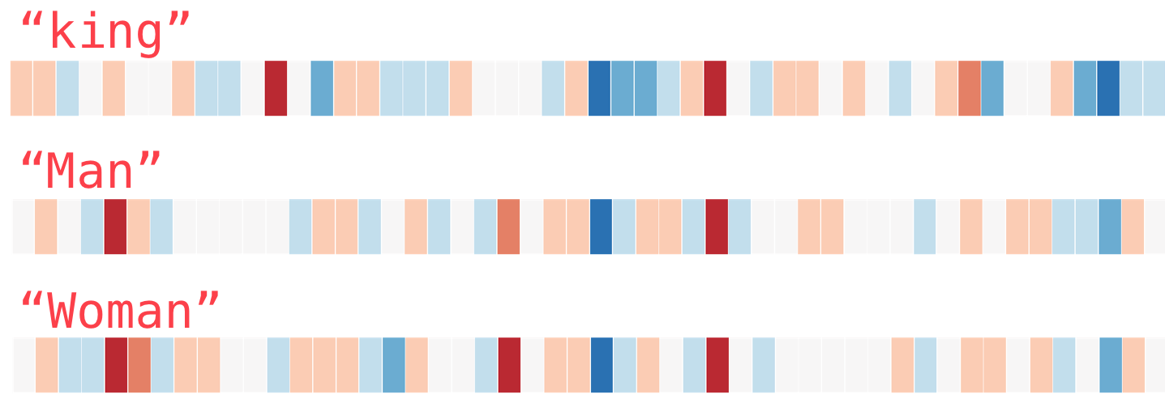
text embedding
Converts text tokens into dense numerical representations (vectors) that capture semantic meaning.
“king”
“man”
“woman”
Typically 300-1000 features
Big idea: represent the “meaning” of a word or phrase by a learned feature vector

Slide 18
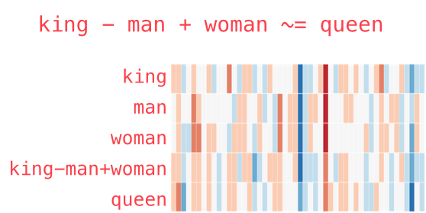
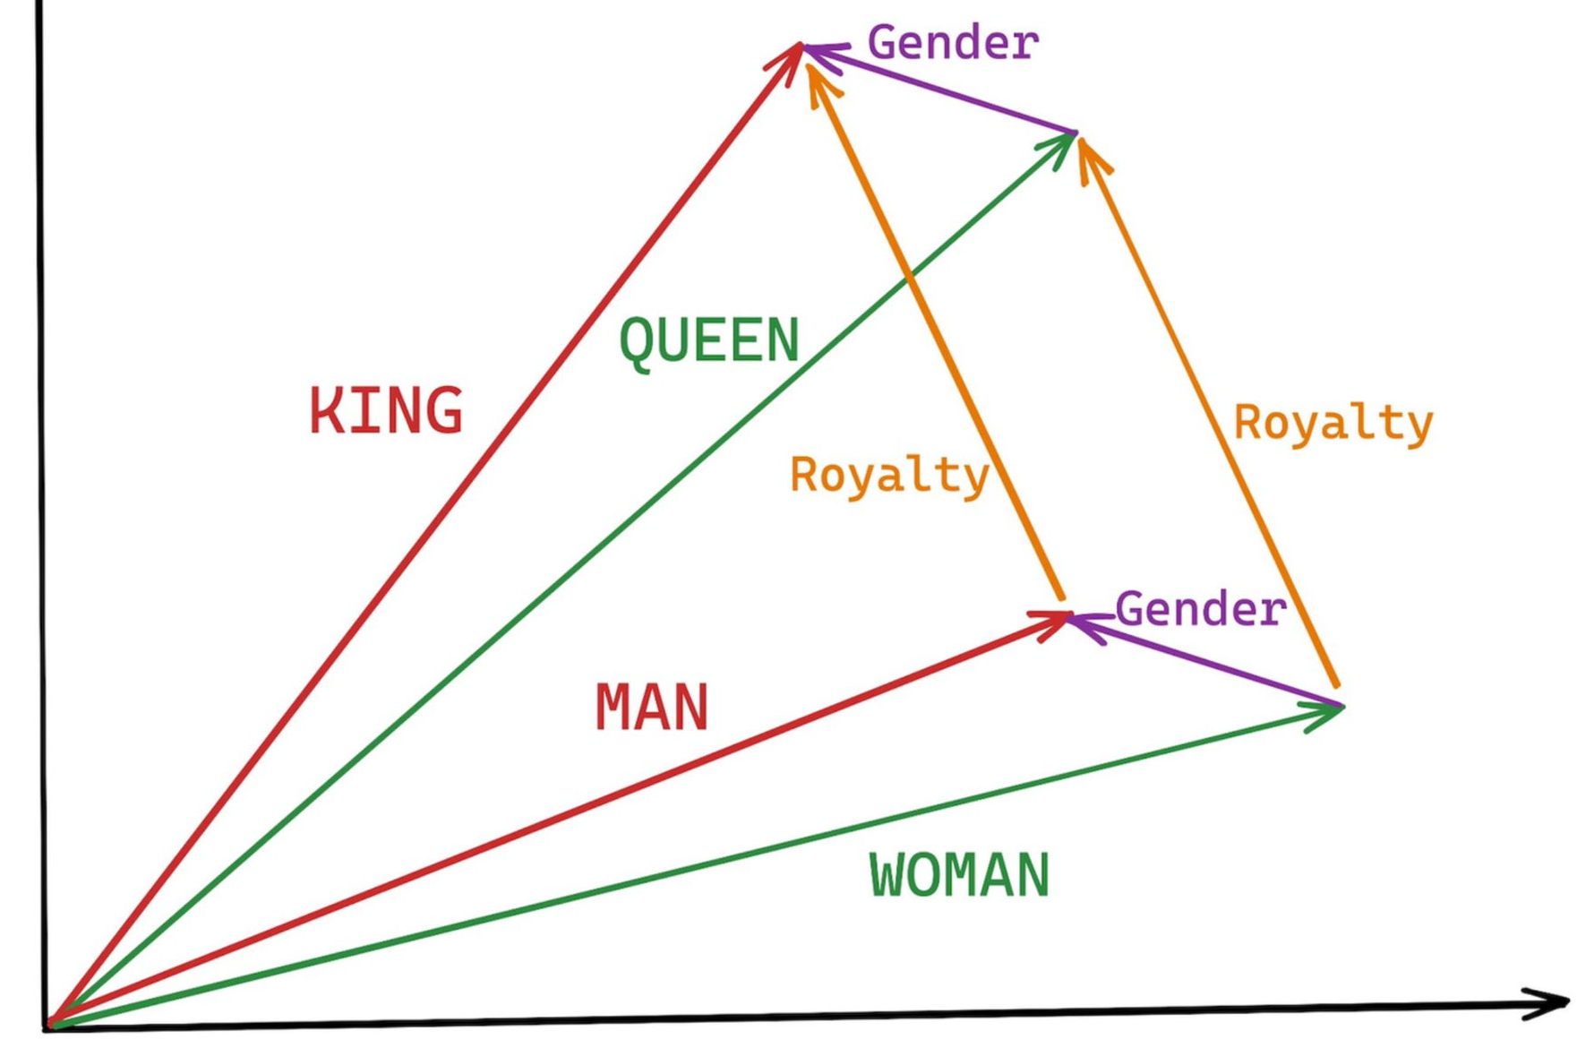
text embedding
Embedding Space
Notes:
How it Works: Text embeddings assign a vector to each token (or sometimes entire phrases/sentences). These vectors are positioned in a multi-dimensional space such that semantically similar tokens are closer together.
• Output: A list of vectors (numerical arrays), one for each token or phrase. These vectors can be used directly in machine learning models.

Slide 19
Emergent mathematical relationships
big – bigger + small --> smaller
France – Paris + Rome --> Italy
au – gold + ag --> silver
Einstein – scientist + Picasso --> painter
Windows – Microsoft + Google --> Android
Sushi – Japan + Germany --> bratwurst

Slide 20
Model Architecture Selection
Choosing an Architecture: The architecture of a model defines its structure and components. Transformers are the architecture of choice for LLMs due to their effectiveness in capturing long-range dependencies in text.
Common architectures include BERT (Bidirectional Encoder Representations from Transformers), GPT (Generative Pretrained Transformer), and others based on transformer layers.
Hyperparameter Selection: Decisions on the number of layers, attention heads, hidden units, batch size, and other parameters are essential in defining the model’s capacity and efficiency.
These choices impact model performance, computational costs, and training time.

Slide 21
Foundation Model Training
Objective: Teach the model language patterns and general knowledge by training it on large datasets with a self-supervised learning objective. Examples of self-supervised tasks include:
Masked Language Modeling (MLM): Used in BERT, where certain words are masked, and the model learns to predict them based on context.
Causal Language Modeling: Used in GPT, where the model learns to predict the next word in a sequence.
Training Process: Involves passing batches of tokenized text through the model and adjusting its weights to minimize prediction errors. This phase is computationally intense, often using powerful hardware (GPUs or TPUs) over several weeks or months.
Optimization: Techniques like Adam optimization and learning rate schedules help the model converge to optimal performance while avoiding overfitting.

Slide 22

Notes:
Once you have a model trained, how do you use it? How do you interact with it?

Slide 23
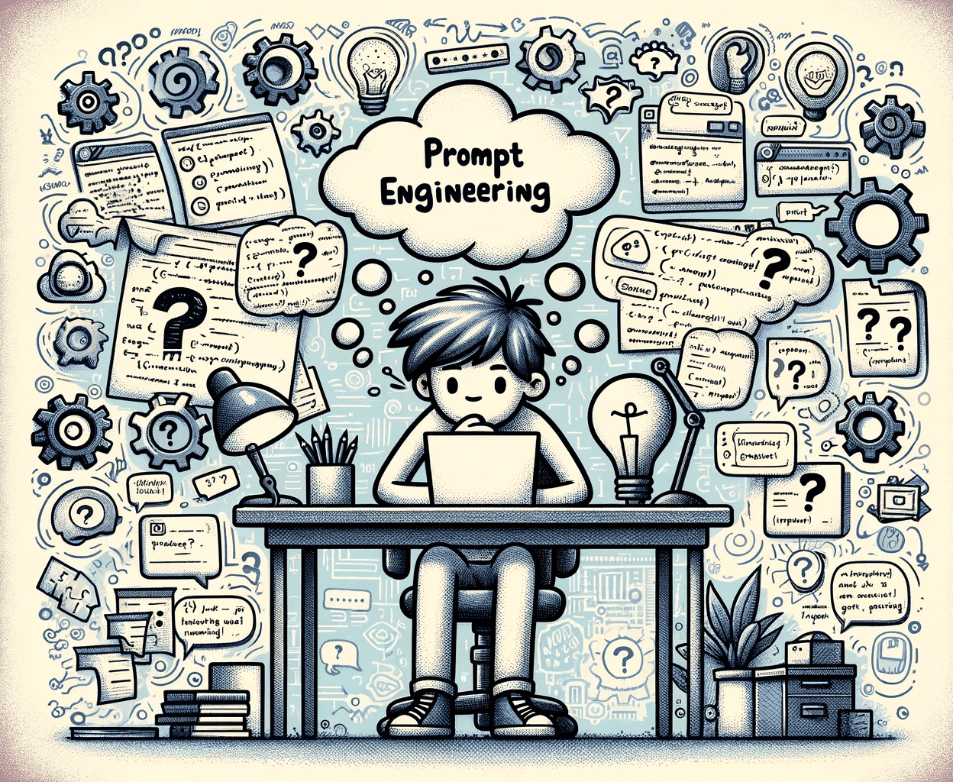
Prompt Engineering
Prompt engineering is the process of crafting inputs, or "prompts," to get large language models (LLMs) like ChatGPT to produce useful and accurate responses.
Effective prompt engineering helps shape how the model interprets and responds to your input, which can enhance its accuracy, creativity, and relevance.

Slide 24
What’s the best prompt?
You are rating movies based on reviews. After each review, rate each movie as "good" or "bad".
Review: <INSERT REVIEW HERE>
Rating: the movie was
Rate the following movie review on a scale of 1 to 10, where “1” is good, and 10 is “bad”.
Review: <INSERT REVIEW HERE>
Rating:

Slide 25
1. Understand Your Goal
Before writing a prompt, clarify your objective. Are you seeking:
Direct information or an answer?
Creative content (e.g., a story, poem, or artwork description)?
Code generation or technical explanations?
Analysis or summarization of a topic?
Knowing your purpose helps you design the prompt to get closer to the desired outcome.

Slide 26
2. Basic Prompt Techniques
Simple Prompting
Start with a straightforward question or command. If you want a direct answer, ask directly:
Example: "What are the main benefits of renewable energy?"
Be Specific
Narrow down the topic or format to limit ambiguity.
Example: "List three environmental benefits of using solar energy over fossil fuels."
Role-Playing
Ask the model to take on a persona or role. This can enhance responses for tasks needing domain-specific expertise.
Example: "As a financial analyst, explain the advantages of investing in index funds for a beginner."

Slide 27
3.1 Advanced Techniques
Few-Shot Prompting
Give the model a few examples in the prompt so it can infer the pattern. This is especially helpful for creative writing, pattern-based tasks, and custom formatting.
Example:css
Copy code
Write a short metaphor about a rainy day. - Example: "The sky wept softly over the silent city." - Example: "Rain tapped its fingers impatiently on the rooftops." - New:
Chain of Thought Prompting
Encourage the model to break down complex problems or provide step-by-step reasoning.
Example: "Explain how photosynthesis works step-by-step, starting with how plants absorb sunlight."
Instructional Prompting
Frame the prompt as an instruction. This helps clarify what output you’re looking for, especially in structured or technical tasks.
Example: "Generate three catchy social media post ideas for a coffee shop's new seasonal drinks."

Slide 28
3.2 Zero-shot prompting
Idea: models have been fine-tuned to follow instructions. Just put your instructions in the prompt
Prompt: Classify the text into neutral, negative or positive.
Text: I think the vacation is okay.
Sentiment:
Notes:
https://www.promptingguide.ai/techniques/ape

Slide 29
3.3 Few-shot prompting
Prompt:
Below are examples of analogies. For each pair, complete the analogy in a similar format.
1. King is to Queen as Man is to Woman.
2. Sun is to Day as Moon is to Night.
3. Cat is to Kitten as Dog is to Puppy.
4. Tree is to Forest as Flower is to ?
Answer:
Prompt:
Translate the following English phrases into Spanish.
1. Hello -> Hola
2. Thank you -> Gracias
3. Good night -> Buenas noches
4. How are you? -> ?
Answer:
In this 2nd prompt, the model is primed with a few translation examples and is expected to complete the last translation accordingly with “¿Cómo estás?”.
In this first prompt, we’ve provided three examples of analogies that show how pairs of related words are structured. After a few examples, the model is expected to follow the same pattern for the fourth analogy by inferring that the answer should be “Garden” or a similarly suitable word.
Notes:
https://www.promptingguide.ai/techniques/ape

Slide 30
3.4 Chain of Thought Prompting
Problem: Calculating Remaining Inventory After Daily Sales and Restocking
Question: "A bookstore has 200 books in stock. Every day, they sell 30 books and restock 20 books. How many books will they have in stock after 10 days?"
Without Chain-of-Thought Prompting
Prompt: "A bookstore has 200 books. They sell 30 books and restock 20 books each day. How many books will they have after 10 days?"
Response: "After 10 days, the bookstore will have 500 books."
Explanation of Error: This answer is incorrect. The model incorrectly multiplies the number of days by the net change (30 - 20) and adds it to the initial amount without considering the day-by-day changes in inventory.
With Chain-of-Thought Prompting
Prompt with CoT: "Let’s break this down step-by-step. Start with 200 books. Each day, calculate how many books are sold and restocked, then find the net daily change. Repeat this for 10 days to get the final count."
Response with CoT:
"Starting with 200 books in stock."
"Each day, they sell 30 books and restock 20, so the net change is -10 books per day."
"Over 10 days, the total change is 10 days × -10 books = -100 books."
"Starting with 200 books, they will have 200 - 100 = 100 books after 10 days."
Final Answer: "After 10 days, the bookstore will have 100 books."
Notes:
Analysis
With chain-of-thought prompting, the model carefully calculates the daily net change, multiplies it by the number of days, and accurately arrives at the correct total. Without CoT, the model skips intermediate steps and miscalculates the inventory, leading to an inflated answer.
Why Chain-of-Thought Works Here
Step-by-Step Calculation: CoT helps the model perform day-by-day calculations rather than shortcutting to a flawed formula.
Avoids Incorrect Multiplication: By verifying each step, the model avoids multiplying the entire number of books by daily operations without taking the daily net change into account.
In scenarios with incremental changes and dependencies across steps, CoT prompting is highly effective in guiding the model to a logical and correct outcome.

Slide 31
Reinforcement Learning from Human Feedback (RLHF)
Definition: RLHF combines human feedback with reinforcement learning, where the model receives rewards based on human feedback. In this setup, the model iterates and optimizes its responses to maximize "reward," which correlates with producing responses that align with human expectations.
How It Works:
The model generates multiple responses to a prompt.
Humans rank these responses by quality, typically using preferences like "best," "okay," or "poor."
A reward model is trained based on this ranking data to assign scores to generated responses.
Reinforcement learning techniques like Proximal Policy Optimization (PPO) use this reward model to fine-tune the LLM, encouraging it to produce responses with higher reward scores in the future.
Example in Practice: In ChatGPT, human reviewers might evaluate responses to complex, open-ended questions like, "Explain quantum computing." They rank outputs based on depth, clarity, and accuracy. The reward model is then trained to favor these higher-ranked answers, and the LLM is subsequently optimized to produce similarly high-quality responses.
Notes:
Real-World Examples
ChatGPT and InstructGPT: OpenAI used RLHF extensively in developing InstructGPT and ChatGPT, where human raters scored model responses. The reward model created from this scoring data fine-tuned the model to provide more helpful, factually correct, and user-aligned responses.
Content Moderation in Social Media: RLHF can also be used to train models to identify and remove harmful content on social media. By incorporating human feedback on what constitutes harmful or offensive content, these models learn to flag similar content more effectively.
Autonomous Vehicles: In training self-driving car systems, human feedback is used to penalize behaviors that lead to unsafe driving scenarios and reward actions that promote safe driving. This feedback, integrated with reinforcement learning, refines the vehicle's decision-making algorithms.

Slide 32
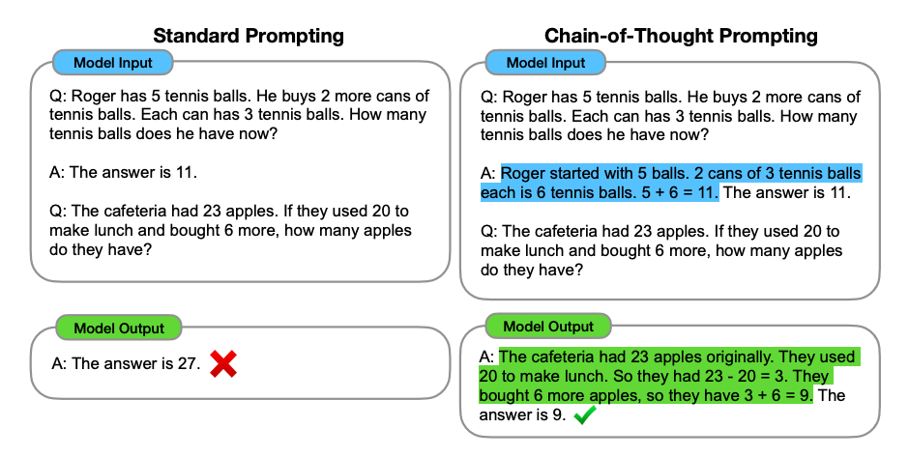
Chain-of-thought prompting
Notes:
https://arxiv.org/abs/2201.11903
https://www.promptingguide.ai/techniques/ape

Slide 33
4. Controlling Output Length and Style
You can ask for specific lengths, tones, or formats:
Length: "Provide a brief summary of climate change solutions in 2-3 sentences."
Tone: "Explain the importance of data security in a friendly, conversational tone."
Format: "Write a bulleted list of key features of electric vehicles."

Slide 34
5. Iterative Refinement
Experiment by adjusting the prompt based on the response quality:
If responses are too vague, add more details or examples.
If too verbose, specify a shorter format.
For instance:
Initial Prompt: "What is quantum computing?"
Revised Prompt: "In two sentences, explain quantum computing to a high school student."

Slide 35
6. Using Constraints for Specificity
If your prompt needs factual accuracy or topical specificity, guide the model with constraints:
Example: "List 5 main events in American history after 1900 with brief descriptions."

Slide 36
7. Prompt Templates for Common Use Cases
Here are some template ideas for frequently used prompt types:
Summarization: "Summarize the following article in 100 words: [paste text]."
Paraphrasing: "Rewrite the following sentence to be more formal: [insert sentence]."
Comparative Analysis: "Compare the features of [Product A] and [Product B] in bullet points."

Slide 37
8. Experimenting and Iteration
Iterating on your prompts is essential because even small changes can have significant impacts on responses. Here’s a process for refining prompts:
Analyze the Response: Look for clarity, relevance, and accuracy.
Adjust Specificity: Add or remove details based on whether the response is too general or overly complex.
Rephrase for Tone: If the tone doesn’t match your goal, try rephrasing to influence the style.
Try it with any of your previous prompts. How did it change?

Slide 38
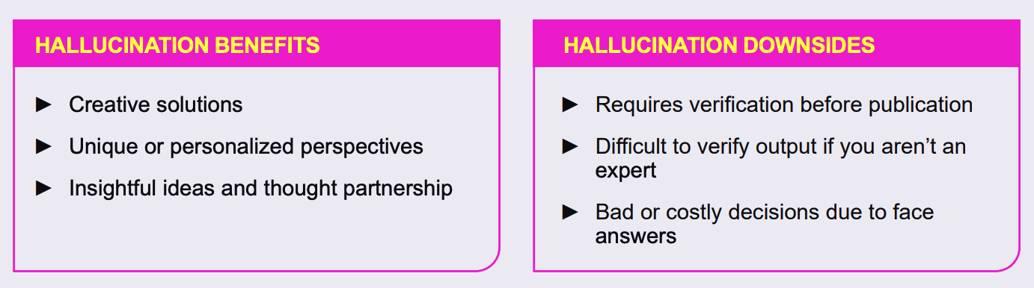
Hallucinations
LLMs are trained on vast amounts of unstructured data, often from the internet, where factual accuracy varies.
They generate text based on probability, not verification, meaning that if certain phrases or patterns are statistically associated—even if inaccurate—the model might generate them confidently.
Hallucination can also occur if the model lacks relevant context or if the user prompt is ambiguous or open-ended.
Real-World Examples of Hallucination:
Medical Advice: If asked about a rare disease, an LLM might fabricate treatments, symptoms, or drug interactions that don't exist.
Historical or Biographical Information: An LLM might confidently state incorrect details about a historical figure. For example, it may claim that a prominent figure won an award they never received or participated in an event they weren’t involved in.
Legal Information: LLMs can also generate fabricated legal information, such as non-existent laws or incorrect legal precedents. For example, a model might cite a court case that sounds legitimate but does not actually exist, which could lead to serious misinformation in legal contexts.

Slide 39
Mitigating Hallucinations
Grounding Models in Real-Time Data: Integrating live or real-time data can help models provide more accurate information.
Retrieval-Augmented Generation (RAG): This approach allows models to reference external knowledge bases, like Wikipedia or specific databases, during generation, which can help ensure answers are accurate.
Human Feedback and Reinforcement Learning: Fine-tuning models with human feedback, especially in critical areas, can reduce the likelihood of hallucination in sensitive fields.

Slide 40
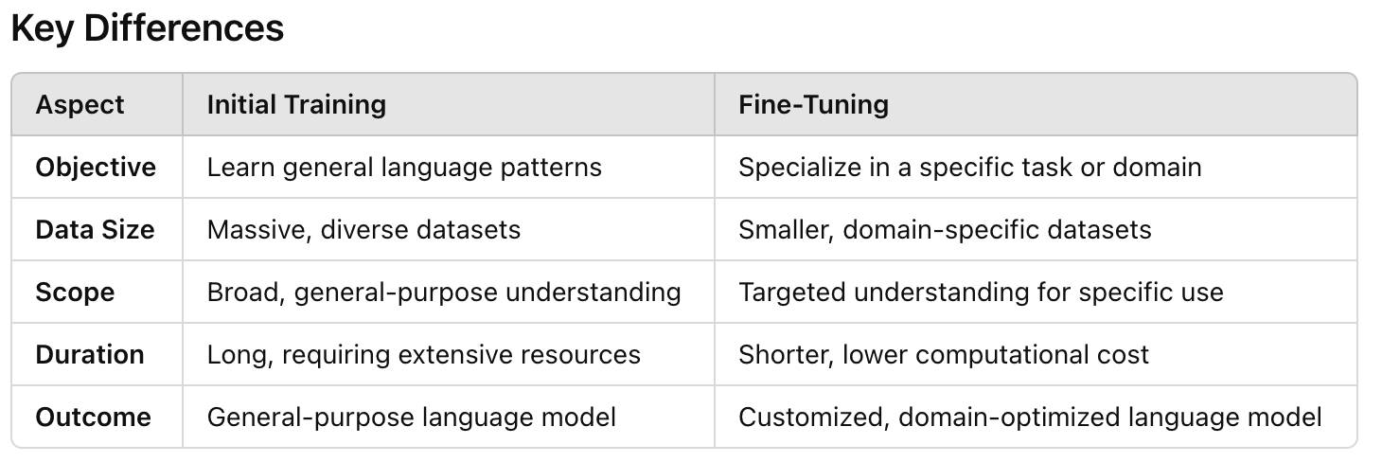
Model Fine-tuning
Model fine-tuning for large language models (LLMs) involves adjusting a pre-trained model on a more specific or smaller dataset to optimize its performance for a particular application or domain.
Fine-tuning is typically conducted after the initial large-scale training phase, where the model is exposed to vast datasets (e.g., Common Crawl, books, and Wikipedia) and learns general language patterns, vocabulary, and syntax.
Fine-tuning helps adapt general-purpose LLMs to niche requirements.
For instance, fine-tuning an LLM for customer support allows it to understand brand-specific language and provide more consistent and on-brand responses.

Slide 41
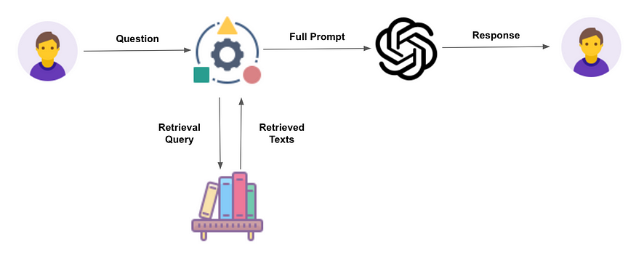
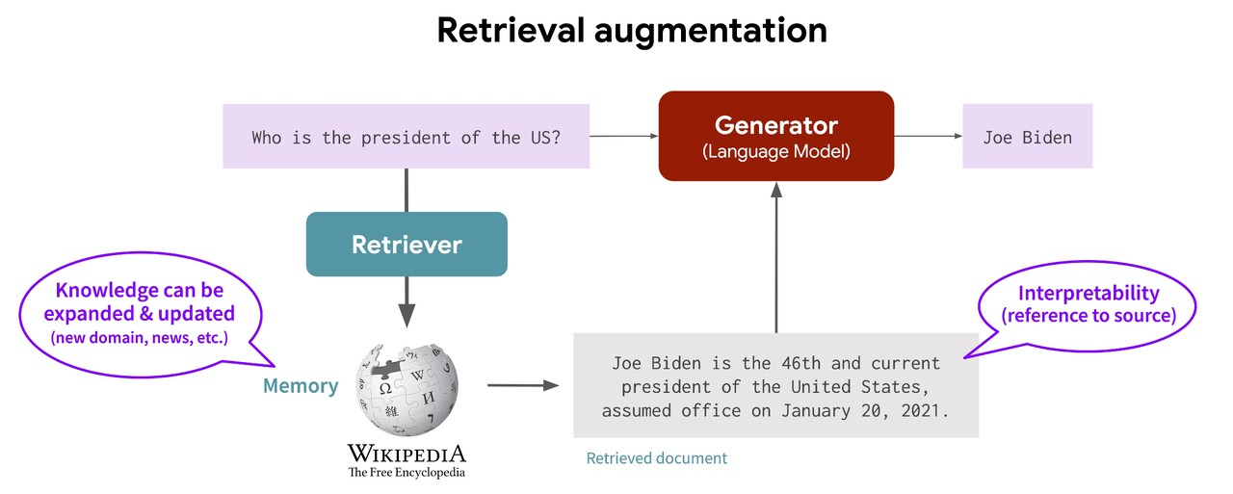
Retrieval Augmented Generation (RAG)
Retrieval-Augmented Generation (RAG) is a technique that enhances the ability of a language model to produce accurate and relevant answers by incorporating external knowledge retrieved in real time.
This approach is particularly valuable in applications where up-to-date or domain-specific information is needed, as it combines the generative strengths of language models with the factual reliability of external data sources.
RAG involves two main components:
Retriever: This module searches a knowledge base or document store to find relevant information in response to a user query.
Generator: Using the retrieved documents as context, the language model generates a response, effectively “grounding” its answer in the provided, factual content.

Slide 42
Steps to implement a RAG Pipeline
Step 1: Prepare the Document Store
A document store is a database of all the text documents you want the model to retrieve information from. Some common options include:
Elasticsearch: A search engine for efficiently querying large volumes of text.
Pinecone or FAISS: Vector databases designed for fast similarity search, useful for finding semantically similar documents.
Custom Knowledge Base: A curated set of articles, manuals, or other data that the retriever can query.
Each document should ideally be chunked into smaller, meaningful sections to improve retrieval quality, such as paragraphs or individual answer sections.
Step 2: Choose or Build the Retriever
The retriever finds relevant documents based on a user query. There are several retriever types:
Keyword-based Retrievers (like BM25): Perform searches based on exact keywords and are common in traditional search engines like Elasticsearch.
Dense Vector Retrievers: Use embeddings (numerical vector representations) generated from deep learning models (e.g., BERT) to find semantically similar documents. Dense retrieval is more flexible and context-aware but requires more computation.
For dense retrieval, common libraries are:
FAISS: Facebook's similarity search library.
Haystack: An NLP library that integrates with both traditional and vector-based retrievers.
Step 3: Choose or Fine-Tune the Generator
The generator is typically a transformer-based model, like GPT-3 or T5, that can process retrieved content and generate a grounded response. Fine-tuning the generator on examples that mimic the RAG format—using documents and related questions and answers—can improve the specificity and accuracy of its responses.
Step 4: Configure the RAG Pipeline
Receive Query: The user inputs a question or prompt.
Retrieve Documents: The retriever searches the document store for the most relevant documents and returns them.
Generate Answer: The retrieved documents are concatenated with the user query and sent to the generator, which synthesizes a response based on both the query and the supporting documents.
Step 5: Handle Post-Processing
Post-processing helps refine the output by:
Filtering Out Irrelevant Content: Checking if the generated response aligns closely with the query.
Confidence Scoring: Using models or rules to ensure responses meet a quality threshold.
Fallback Mechanisms: Implementing alternatives, like “I’m not sure” responses, if no relevant information is found.
Notes:
Step 6: Evaluate the System
Evaluating a RAG system can involve:
Automatic Metrics: BLEU, ROUGE, or F1 scores, particularly in structured Q&A settings.
Human Evaluation: Real-world users assess the accuracy and relevance of responses.
Retrieval Accuracy: Monitoring whether the retriever consistently selects relevant documents by analyzing retrieval metrics like Mean Reciprocal Rank (MRR).
Real-World Applications of RAG
Customer Support: RAG enables customer service bots to access support manuals, troubleshoot databases, and policy documentation, providing users with accurate and contextually relevant responses.
Medical or Legal Consultation: Professionals in these fields can quickly access domain-specific information, allowing LLMs to retrieve and cite relevant guidelines or case precedents.
News Summarization and Fact-Checking: By accessing a live database of news articles, a RAG model can generate real-time news summaries or check facts against known sources.
Libraries and Tools for RAG
Some popular libraries and tools for building RAG pipelines include:
Hugging Face Transformers: Offers pre-trained models and the RAG model architecture for retrieval-augmented tasks.
Haystack: A full-featured NLP framework that integrates retrieval and generation for creating RAG-based applications.
Elastic and Pinecone: For building and querying large document stores with dense or sparse retrieval options.

Slide 43
References
Reference | Focus / What you’ll learn
“Suno: potential, prospects and trends” (Yu et al., 2024) | A high-level survey of Suno’s capabilities, outlining a general technical framework for AI music generation (symbolic vs audio, model categories, etc.).
“A Fourier Explanation of AI‑music Artifacts” (2025) | Focused on artifact analysis in AI-music (including Suno). Very useful for understanding the signal-processing / architecture tradeoffs (e.g., decoder/layout choices causing artefacts).
“Inside Suno v5 – Model Architecture & Technical Mechanics” by Jack Righteous | A non-peer-reviewed but detailed write-up claiming to explain how Suno v5 uses a hybrid of transformer sequencing + diffusion for audio generation. Good for architectural intuition.
API & developer docs: the official “Suno API Documentation” site | Less about deep model internals, but covers system architecture, endpoints, workflows and how the system is deployed/integrated — helpful for applied engineering.
Case studies / data-driven analyses: “Data‑Driven Analysis of Text‑Conditioned AI‑Generated Music: A Case Study with Suno and Udio” (2025) | Provides empirical evaluation of usage, prompting strategies, and generated output quality — useful for linking architecture to behavior in the real world.

Slide 44
References
Reference | Summary & What You’ll Learn
“Suno: potential, prospects and trends” (Zhang et al., 2024) | A peer-reviewed article summarizing AI-music generation in general, then focusing on Suno. Covers text-to-song pipelines (lyrics, voice synthesis, audio generation) and discusses Suno’s technical framework. Great for high-level “what & why”.
“Data-Driven Analysis of Text-Conditioned AI-Generated Music: A Case Study with Suno and Udio” (Casini et al., 2025) | Empirical study of how Suno and its peer Udio are used: prompt distributions, genres, and user behavior. Helpful in seeing how the architecture is used in practice and what kinds of outputs result.
“Suno AI: Advancing AI-Generated Music with Deep Learning” (TechRxiv) | A preprint/essay-style piece focusing on the deep-learning backbone of Suno (GANs, Transformers, diffusion models). Not peer-reviewed, but gives helpful pointers to model types and architecture choices.
“SunoCaps: A novel dataset of text-prompt based AI-generated music” | Research on a dataset generated with Suno: good for understanding data issues, prompt→audio mapping, evaluation. Helpful if you are interested in training/benchmarks.
“The Use of AI in Creating Music Compositions: A Case Study on Suno …” (Atlantis-Press) | Conference-style paper that describes the application of Suno for non-musicians; contains technical walkthroughs of the pipeline. Useful as bridging theory → practice.

